Slide 1
Independent Samples and Paired T-Tests and Correlations

Slide 2
Inference About Two Samples
In earlier lectures, we assumed that we only had a single sample, and tried to make inferences about population parameters using corresponding sample statistics. E.g.:
Confidence Interval about a mean
Hypothesis Test about a mean
Now, assume we have two samples. E.g.:
Stress levels in Treatment and Control groups in a trial
Philly incomes vs. New York incomes
SAT scores of Penn vs. Harvard incoming freshmen
Goal: To compare the two groups and make a statement about whether
the means of the corresponding variable (stress, incomes, SAT scores) in
the populations from which the groups come are significantly different.

Slide 3
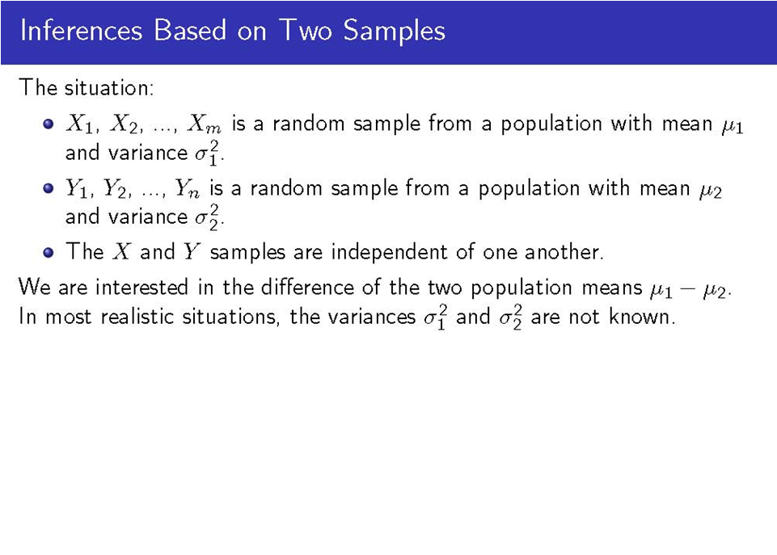
Example:
Assume you have 40 Philly residents and 50 NY residents, and the incomes of the Philly residents will be denoted as X1, X2,…,X40, and the incomes of the NY residents will be denoted as Y1, Y2,…,Y50. The mean of the population from which the 40 Philly residents are taken is denoted by μ1, and the variance of this population is denoted as σ₁². The mean of the population from which the 50 NY residents are taken is denoted by μ2, and the variance as σ₂². Is μ1 = μ2 ?

Slide 4
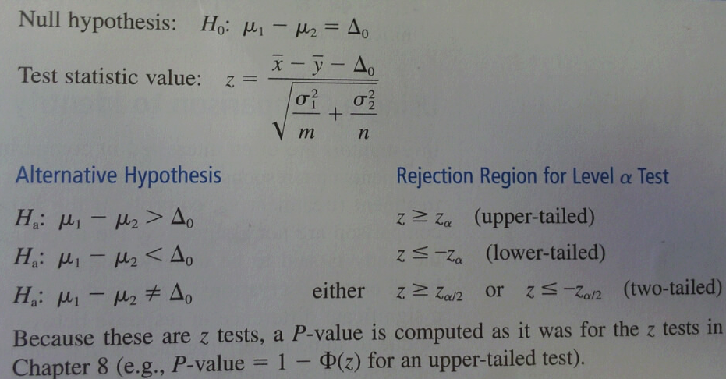

Hypothesis Tests
Case I: When we have normal populations with known variances (quite unrealistic)
Generally, $∆_{0}$= 0

Slide 5

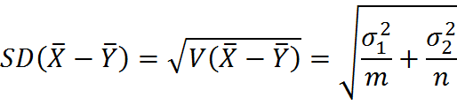
Standardizing the Difference
In the formula for z on the previous slide, all we’re doing is standardizing the variable of interest, as usual. Here, the variable of interest is X̅ - Y̅, the difference of the two sample means. To standardize, we subtract the expected value of the variable, and divide by the standard deviation. The expected value and the variance are computed as follows:

Slide 6
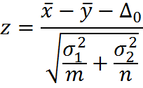
Example (known population S.D.’s)
Assume you have a sample of 20 weight lifters, and their average body mass index (BMI) is X̅ = 29.8. Assume you also have a sample of 30 sumo wrestlers, and their average BMI is Y̅ = 34.7. Assuming that BMI’s in the two populations are normal, with σ1 =4.0 and σ2 = 5.0, does the data indicate that the BMI of weight lifters and sumo wrestlers is different?
Parameter of Interest: Δ0 = μ1 - μ2, the difference between true average BMIs of weight lifters and sumo wrestlers under H0.
H0: μ1 - μ2 = Δ0 = 0; Ha: μ1 - μ2 ≠ Δ0 = 0 (2-tailed test)
With Δ0 = 0 (under H0), the test statistic value is
Substituting Δ0 = 0, m=20, x̅=29.8, σ1=4.0, n=25,
y̅=34.7, and σ2 = 5.0, we get z=-3.66.
In R, the p-value that corresponds to z=-3.66 can be computed with formula =2*(1-pnorm(abs(-3.66))) = 0.000252.
Because p < 0.05, REJECT the null hypothesis!
Notes:
This means that if the difference between the true BMIs of sumo wrestlers and weight lifters is 0, the probability of obtaining a BMI difference of 34.7-29.8 = 4.9 due to sampling variation is 0.000252.

Slide 7
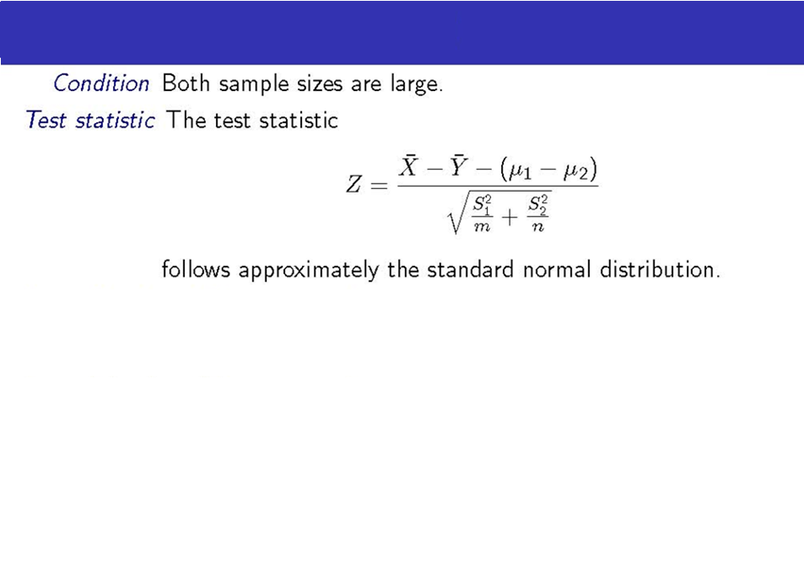
Tests Based on Large Samples
Essentially, this is the same formula as before. But if we don’t know the standard deviations of the two populations (and we typically do not), and both sample sizes are large, we can simply plug in S for σ.
The use of the test statistic z above, along with the previously stated upper-, lower-, and two-tailed rejected regions based on z critical values gives large sample tests whose significance levels are approximately α. A P-value is computed exactly as it was for our earlier z-tests.

Slide 8
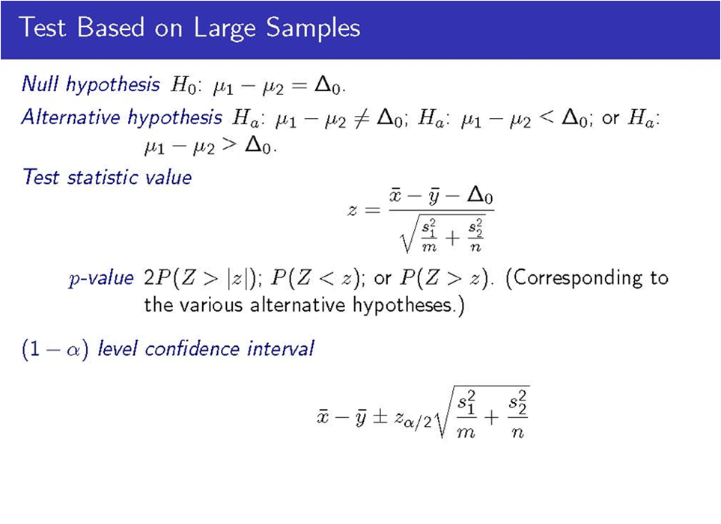
(See p. 315 of Devore)

Slide 9
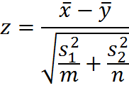
Example
Assume that you’re trying to compare two brands of hot dog in terms of fat content. Assume that 50 hot dogs are sampled from the first brand, and the average (s.d.) fat content is 26.7 g (3.0 g), and 100 hot dogs are sampled from the second brand, and the average (s.d.) fat content is 25.3 g (2.0 g). Are the two brands significantly different in terms of fat content at the 0.05 significance level?
Parameter of Interest: Δ0 = μ1 - μ2, the difference under H0.
H0: μ1 - μ2 = Δ0 = 0; Ha: μ1 - μ2 ≠ Δ0 = 0 (2-tailed test)
With Δ0 = 0 (under H0), the test statistic value is
For α = 0.05, α/2 = 0.025, and zα/2 = 1.96.
Substituting m=50, x̅=26.7, s1=3.0, n=100, y̅=25.3,
and s2 = 2.0 in the formula above, we get z=2.98.
(Two-Tailed) P-value = 2(1-Φ(|z|)) = 2(1-Φ(2.98)) = 2(1-0.999)=0.003
In R: 2*(1-pnorm(abs(2.98)))
Because p-value = 0.002 < 0.05, we reject the null hypothesis!

Slide 10

Example (Cont’d)
Assume that you’re trying to compare two brands of hot dog in terms of fat content. Assume that 50 hot dogs are sampled from the first brand, and the average (s.d.) fat content is 26.7 g (3.0 g), and 100 hot dogs are sampled from the second brand, and the average (s.d.) fat content is 25.3 g (2.0 g). Calculate the 95% confidence interval for the difference.
For α = 0.05, α/2 = 0.025, and zα/2 = 1.96.
Substituting zα/2 = 1.96, m=50, x̅=26.7, s1=3.0, n=100, y̅=25.3, and s2 = 2.0 in the formula above, we get (0.48, 2.32)
Lower bound: (26.7-25.3)-(1.96*SQRT((9/50)+(4/100))) = 0.48
Upper bound: (26.7-25.3)+(1.96*SQRT((9/50)+(4/100))) = 2.32
Because 0 is not in the 95% confidence interval, we can reject the H0: μ1 - μ2 = 0 at the 0.05 significance level – as on previous slide.

Slide 11
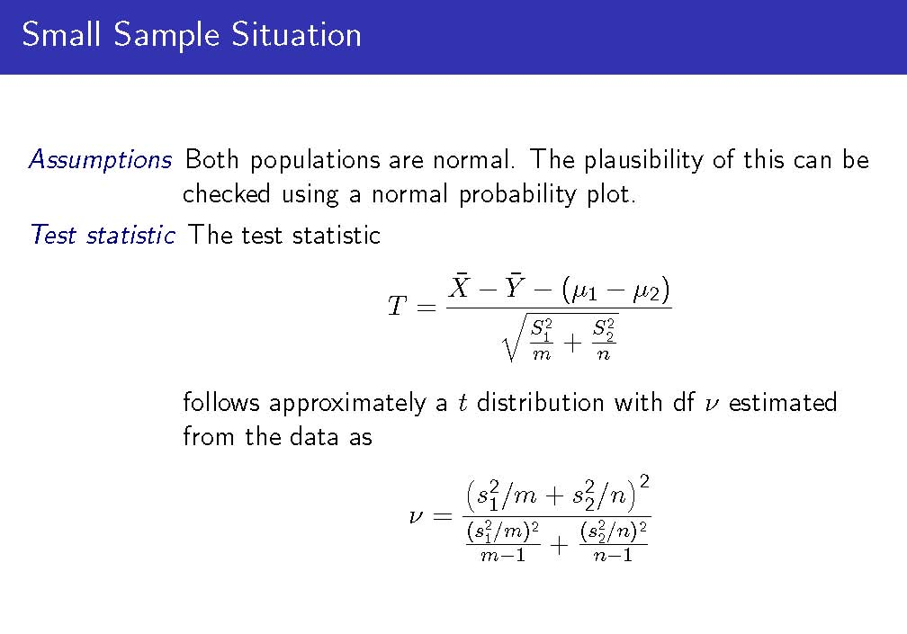
(round this down to the nearest integer)

Slide 12
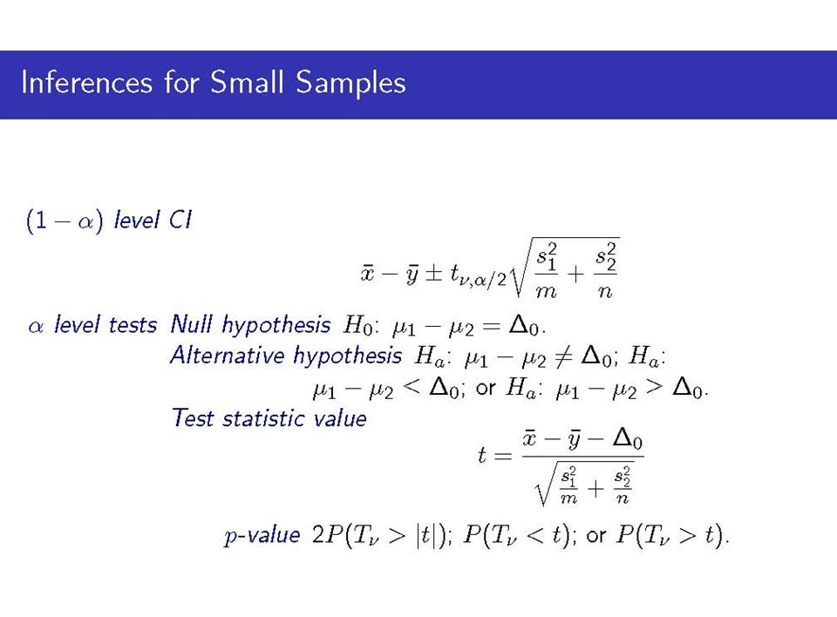
(See p. 316 of Devore)

Slide 13
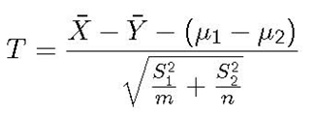
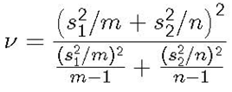
Example
Now, 10 hot dogs are sampled from the 1st brand, and the mean (s.d.) fat content is 26.7 g (3.0 g), and 15 hot dogs are sampled from the 2nd brand, and the mean (s.d.) fat content is 25.3 g (2.0 g). Are the brands significantly different in terms of fat content at the 0.05 sig. level?
Parameter of Interest: Δ0 = μ1 - μ2, the difference under H0.
H0: μ1 - μ2 = Δ0 = 0; Ha: μ1 - μ2 ≠ Δ0 = 0 (2-tailed test)
With Δ0 = 0 (under H0), the test statistic value is
The formula for df =
Substituting m=10, x̅=26.7, s1=3.0, n=15, y̅=25.3, and s2 = 2.0 in the formulas above, T= 1.29 and ν = 14.32. Rounding down, ν = 14.
P-Value in R: 2*(1-pt(abs(1.29),14)) = 0.22 > 0.05 -> Can’t reject H0!
Now, let’s do the example entirely in R
Notes:
For α = 0.05, tα/2, ν = t0.025, 14 = 2.145.

Slide 14

Example (Cont’d)
Assume that you’re trying to compare two brands of hot dog in terms of fat content. Assume that 10 hot dogs are sampled from the first brand, and the average (s.d.) fat content is 26.7 g (3.0 g), and 15 hot dogs are sampled from the second brand, and the average (s.d.) fat content is 25.3 g (2.0 g). Calculate the 95% confidence interval for the difference.
We saw that here, ν = 14. For α = 0.05, tα/2, ν = t0.025, 14 = 2.145.
Substituting t0.025, 14 = 2.145, m=10, x̅=26.7, s1=3.0, n=15, y̅=25.3, and s2 = 2.0 in the formula above, we get (-0.92, 3.72)
Lower bound: (26.7-25.3)-(2.145*SQRT((9/10)+(4/15))) = -0.92
Upper bound: (26.7-25.3)+(2.145*SQRT((9/10)+(4/15))) = 3.72
As 0 IS in the 95% confidence interval, we can’t reject H0: μ1 - μ2 = 0 at the 0.05 significance level. Compare to z-test with larger m and n.

Slide 15
Applications and Causality
In practice, t-tests typically replace z-tests, for all sample sizes.
T-tests are often used in correlational or observational studies, but shouldn’t be used to determine causality.
Researchers might use the t-test to compare the treatment and control groups in an experiment, to see if the treatment is associated with a better mean outcome (e.g., experimental group has lower distress, lower illness duration, etc.)
It’s important to note here that if the treatment group had a significantly better outcome than the control group, it doesn’t necessarily mean that the treatment caused the better outcome.
You could say that the treatment is associated with a better outcome.
Determining causality is difficult, and requires temporal precedence (cause must come before effect), and certain experimental designs and analytic methods that are beyond the scope of this course.
All the other methods we’ll cover in this course also should not be used to make causal statements.

Slide 16
Paired t-tests
Assume you have a situation where you have two observations for each individual (e.g., HSCL-25 stress levels before and after treatment; two tests scores, etc).
These are no longer independent samples. How would you test whether the mean HSCL-25 score before treatment (here, 1.78) is different from the mean HSCL-25 score after treatment (here, 1.70)
Subject | HSCL-25 Score Before Treatment | HSCL-25 Score After Treatment
1 | 1.78 | 1.52
2 | 2.23 | 2.24
3 | 1.43 | 1.38
4 | 1.88 | 1.75
5 | 1.78 | 1.78
6 | 1.29 | 1.34
7 | 1.85 | 1.43
8 | 1.67 | 1.70
9 | 1.89 | 1.99
10 | 2.00 | 1.88
Mean | 1.78 | 1.70
SD | 0.27 | 0.29

Slide 17
Just Take the Difference…
Subject | HSCL-25 Score Before Treatment | HSCL-25 Score After Treatment | Difference (After - Before)
1 | 1.78 | 1.52 | -0.26
2 | 2.23 | 2.24 | 0.01
3 | 1.43 | 1.38 | -0.05
4 | 1.88 | 1.75 | -0.13
5 | 1.78 | 1.78 | 0.00
6 | 1.29 | 1.34 | 0.05
7 | 1.85 | 1.43 | -0.42
8 | 1.67 | 1.70 | 0.03
9 | 1.89 | 1.99 | 0.10
10 | 2.00 | 1.88 | -0.12
Mean | 1.78 | 1.70 | -0.08
SD | 0.27 | 0.29 | 0.16
Subtract the ‘After’ score from the ‘Before’ score to get the difference in HSCL-25 scores (i.e., decrease in symptoms).
Calculate the mean and s.d. of the difference.
If there is no change, we expect the mean of the difference to not be significantly different from 0.
If there is change, then we expect the mean difference to be significantly different from 0.
So this reduces to a 1 sample hypothesis test!
H0: μDifference = 0 vs. Ha: μDifference ≠ 0

Slide 18
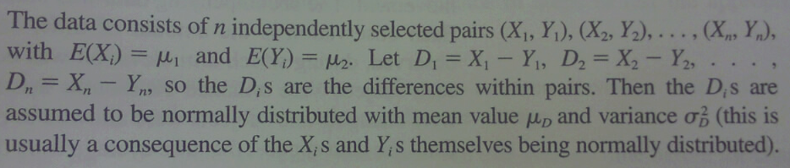
Assumptions

Slide 19
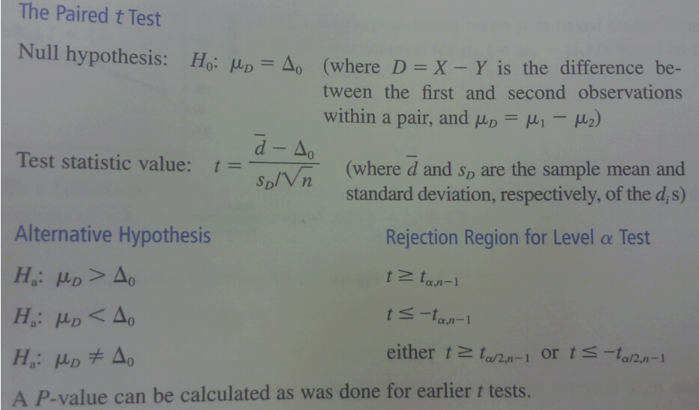
To State It Formally…

Slide 20

Back to Our Example - Let’s Test It!
Parameter of interest: μD, which is the true average difference between the first and second HSCL-25 assessment scores
H0: μD = 0 and Ha: μD ≠ 0
Statistic:
Plugging in d̅ = -0.08; S.D. = 0.16; n = 10 into the formula above, we get t = -0.08/(0.16/√10) = -1.58
Because we’re doing a two-tailed test, the rejection region is either t ≥ tα/2,ν or t ≤ - tα/2,ν. Here, ν = df = n-1 = 9. Assume we want the test at the 0.05 significance level, so α = 0.05 and α = 0.025, and tα/2,ν = t0.025,9 = 2.262.
Because we would reject H0 if -1.58 = t ≤ - tα/2,ν = -2.262, and this is not the case (i.e., -1.58 > -2.262), we cannot reject H0. DO IN R!

Slide 21
Data Format
Generally, you would rarely do independent samples or paired t-tests by hand.
Independent Samples T-Test (AKA Two Sample T-Test)
In the data, for each ID, there is a group variable (treatment vs. control) and the variable of interest (HSCL-25)
Paired T-Test (Just like the One Sample T-Test)
In the data, for each ID, there are two variables – the first HSCL-25 score, and the second HSCL-25 score. You are expected to create the variable (call it Difference), which is the difference between the 1st and 2nd scores.
ID | Group | HSCL-25
1 | TREATMENT | 1.78
2 | CONTROL | 2.31
3 | TREATMENT | 1.63
4 | CONTROL | 2.01
ID | HSCL-25 (Before) | HSCL-25 (After) | HSCL-25 (Diff)
1 | 1.73 | 1.78 | -0.05
2 | 2.48 | 2.31 | 0.17
3 | 1.99 | 1.63 | 0.36
Create this Difference Variable if it’s not there
2 - Sample
Vs.
1 - Sample

Slide 22
What happens if…
Your variable of interest is continuous but not normal, and the sample size in each of the two (independent) samples is small?
Use non-parametric t-tests (See Chapter 15 of Devore)
Your variable is continuous, and there are more than two independent samples:
If the variable is normal, use ANOVA (Analysis of Variance)
If the variable is not normal, use non-parametric ANOVA (See Chapter 15)
You have two variables, both categorical (with two or more categories each), and you have a contingency table as below:
Use χ² (Chi-squared) tests to determine whether the gender distribution is different for each race category, or conversely, whether the race distribution is different for each gender (See Chapter 14.3)
 | Black | White | Asian | Other | TOTAL
Male | 35 | 68 | 23 | 13 | 139
Female | 27 | 33 | 28 | 10 | 98
Transgender | 5 | 8 | 3 | 1 | 17
TOTAL | 67 | 109 | 54 | 24 | 254

Slide 23
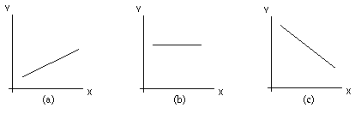
Remember Algebra 1?
X and Y are directly related (slope is positive)
X and Y are not related, or independent – for any value of X, Y is the same (slope is zero)
X and Y are inversely related (slope is negative)

Slide 24
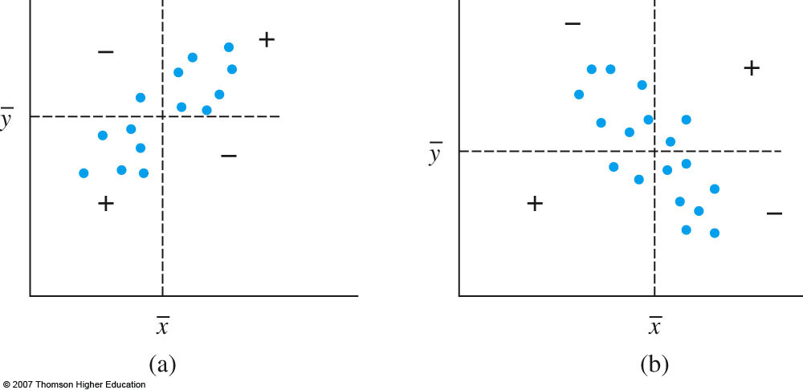
Variable Relationships
Assume we’re interested in seeing if two variables x and y are related.
Given n pairs of observations (x1, y1), (x2, y2), … , (xn,yn), x and y have a positive (direct) relationship if large x’s are paired up with large y’s and small x’s are paired up with small y’s; similarly, if large x’s are paired up with small y’s and small x’s are paired up with large y’s, then the relationship between x and y is negative (inverse).

Slide 25
Sample Correlation and Covariance
Covariance
A measure of how much two variables X and Y change together
The units of Cov (X, Y) are those of X multiplied by those of Y
Quite difficult to interpret
The covariance of a variable X with itself is simply the variance of X
Correlation
A standardized measure of the strength of the relationship between variables, known as correlation (r), is often used instead.
Value of r doesn’t depend on which variable is labeled x and which y
Value of r is independent of units of measurement of x and y
-1 ≤ r ≤ 1
r = 1 iff all (xi, yi) pairs lie on a straight line with positive slope and r=-1 iff all (xi, yi) pairs lie on a straight line with negative slope
r = 0 indicates a lack of a (linear) relationship between the variables

Slide 26

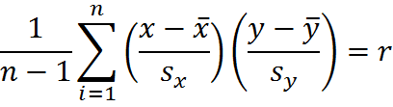
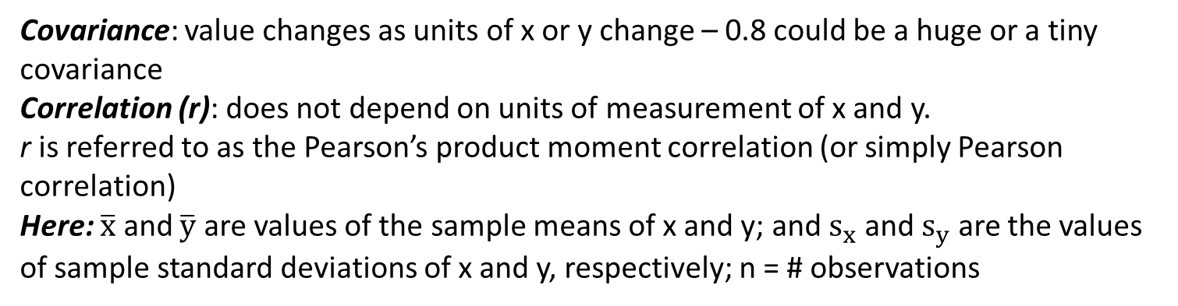
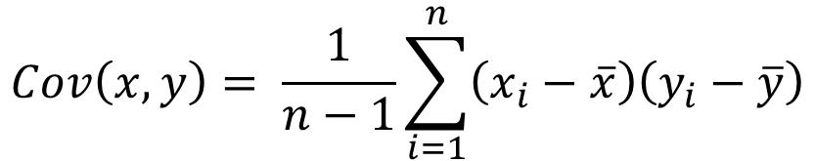
Sample Correlation and Covariance
$$Cov\left(x,y\right)= \frac{1}{n−1}\sum_{i=1}^{n}{\left(x_{i}−\overline{x}\right)\left(y_{i}−\overline{y}\right)}$$
=
i i
Covariance: value changes as units of x or y change – 0.8 could be a huge or a tiny covariance
Correlation (r): does not depend on units of measurement of x and y.
r is referred to as the Pearson’s product moment correlation (or simply Pearson correlation)
Here: $\overline{x}$ and $\overline{y}$ are values of the sample means of x and y; and $s_{x}$ and $s_{y}$ are the values of sample standard deviations of x and y, respectively; n = # observations

Slide 27
Sample Correlation Calculation
i i
In English:
In a data set with $n$ observations, the correlation coefficient $r$ between variables $x$ and $y$ can be calculated as follows:
1. Find the mean values of the variables $x$ and $y$ (denoted by $\overline{x}$ and $\overline{y}$)
2. Find the standard deviation values of the variables $x$ and $y$ (denoted by $s_{x}$ and $s_{y}$).
3. For each observation $i$, do the following:
a. Subtract $\overline{x}$ from $x$, and divide the difference by $s_{x}$.
b. Subtract $\overline{y}$ from $y$, and divide the difference by $s_{y}$.
c. Multiply 3.a by 3.b.
4. Calculate the sum of 3.c across all observations $i$.
5. Divide the sum in 4 above by the $n – 1$.

Slide 28
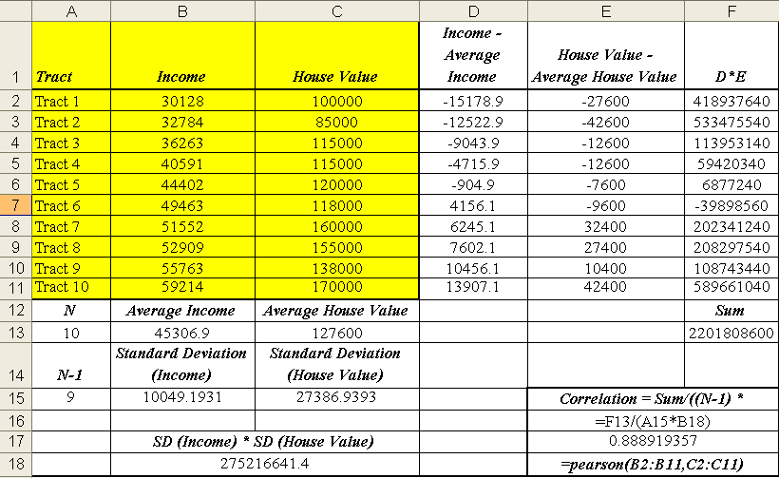
Example

Slide 29
Following the Steps on the Previous Slide…
Calculate Average Income across all tracts (Cell B13) and Average House Value (Cell C13) across all tracts.
For each tract,
Subtract the Average Income (B13) from the tract Income (column B). This difference can be found in column D.
Subtract the Average House Value (C13) from the tract House Value (column C). This difference can be found in column E.
Multiply the value in column D by the value in column E (product is in column F).
Add up the values in column F (the sum is in cell F13).
Calculate the standard deviation of Income (Cell B15) and the standard deviation of House Value (Cell C15).
Divide cell F15 by the product of B15, C15, and A15 (A15 is simply the number of observations minus 1).The result, in cell E17, is the correlation of income and house value. Note that the same value can be obtained with the formula in cell E18.

Slide 30
Positive Correlation – Example
As the values of one variable increase, so do the values of the other variable
E.g., there is a strong positive correlation between income and years of school.
Years of Schooling | Income (in $1,000)
8 | 20
9 | 21
10 | 25
11 | 27
12 | 30
13 | 38
14 | 40
15 | 41
16 | 50
17 | 60

Slide 31
Negative Correlation – Example
As values of one variable increase, the values of the other variable decrease.
For instance, in higher income neighborhoods, there tend to be lower rates of violent crime (e.g., # of robberies per 10,000 people)
Area | Income | Robberies per 10,000 people
A | $30,000 | 36
B | $40,000 | 33
C | $50,000 | 27
D | $60,000 | 25
E | $70,000 | 20
F | $80,000 | 18
G | $90,000 | 14
H | $100,000 | 15
Number of Robberies per 10,000 People vs. Income

Slide 32
Zero Correlation – Example
There is no (linear) relationship between two variables
E.g., median house value and average amount of rain (in inches) for a number of cities
City Name | House Value | Inches of Rain
A | 150000 | 30
B | 160000 | 25
C | 140000 | 27
D | 120000 | 21
E | 130000 | 17
F | 200000 | 17
G | 180000 | 28

Slide 33
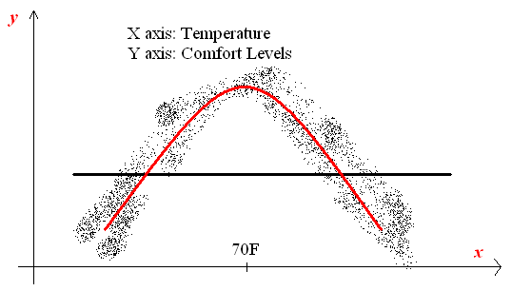
Zero Correlation: No Relationship?
It only means that there is no linear relationship between
the variables. Consider the following example:
There is a clear quadratic relationship here, even though the correlation coefficient would be zero.

Slide 34
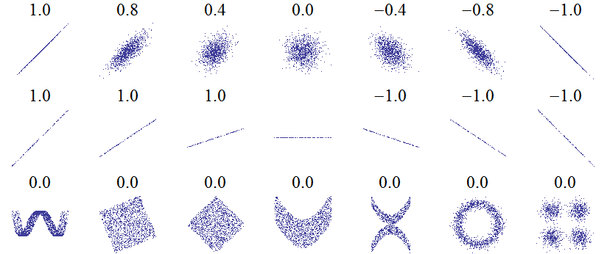
Scatterplots and Correlations
Source: http://upload.wikimedia.org/wikipedia/commons/0/02/Correlation_examples.png

Slide 35
Some Remarks
A correlation of a variable and itself is always 1.
In practice, we rarely see perfect positive or negative correlations (i.e., correlations of exactly 1 or -1)
What is a high correlation, what is a low correlation?
Depends on the field
Devore (p. 531) states the following rule of thumb:
0 ≤ |r| ≤ 0.5: weak correlation
0.8 ≤ |r| ≤ 1: strong correlation
Otherwise (between 0.5 and 0.8): moderate correlation
There might be confounding factors that explain a strong positive or negative correlation between variables
E.g., volume of ice cream consumption might be correlated with crime rates. Why?

